Slide 1
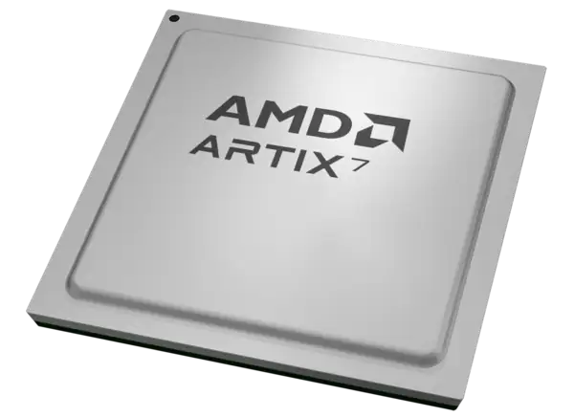
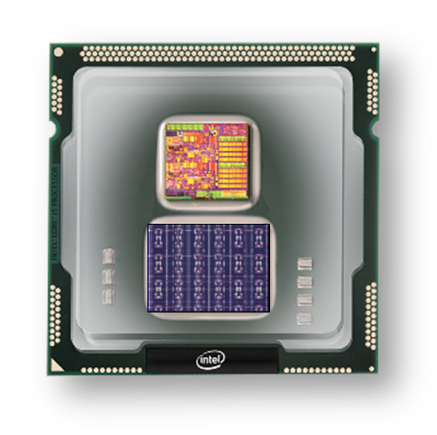

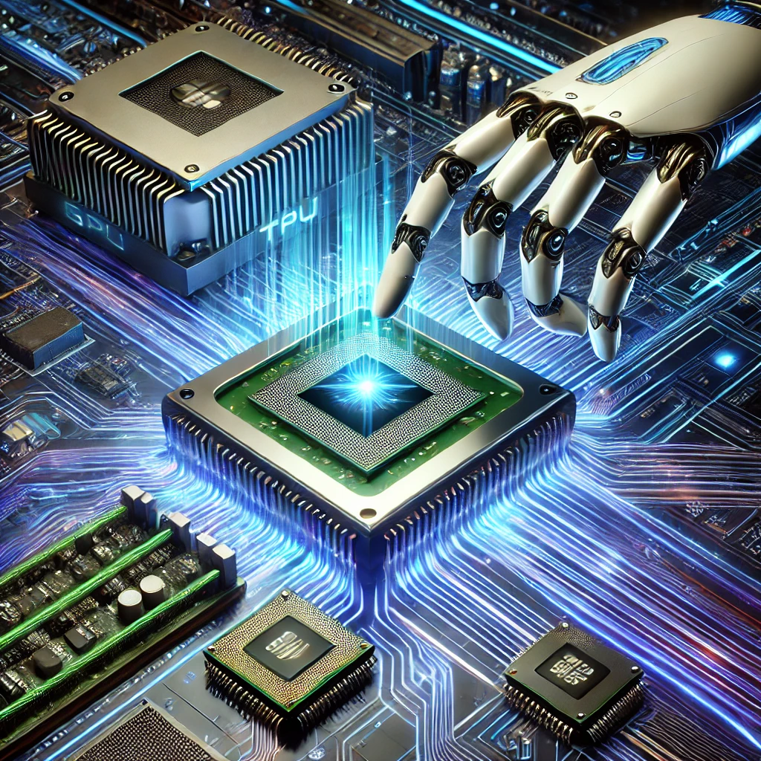
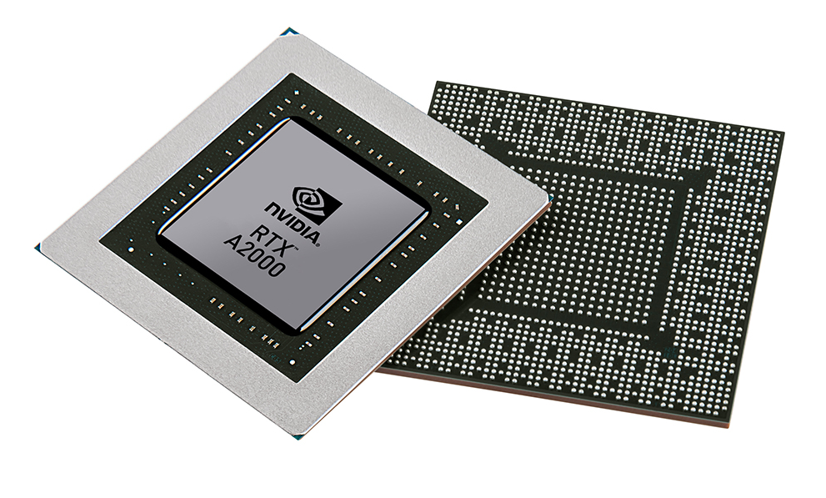


Christof Teuscher
ECE 410/510: Hardware for AI and ML
Emerging devices and technologies
Portland State University
Department of Electrical and Computer Engineering (ECE)
www.teuscher-lab.com
teuscher@pdx.edu

Slide 2
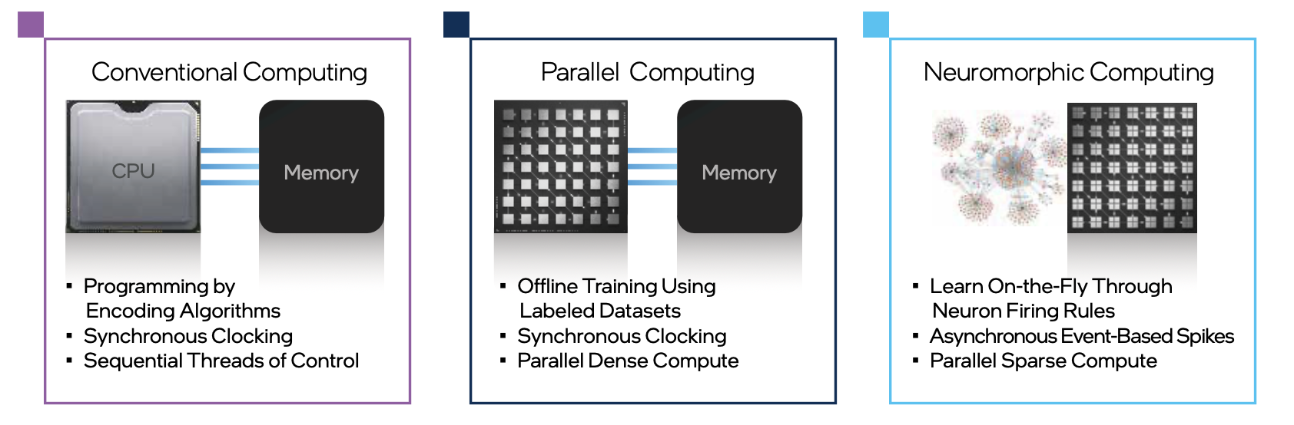
Unconventional computing
Unconventional Computing
?
Technology Brief | Taking Neuromorphic Computing to the Next Level with Loihi 2

Slide 3
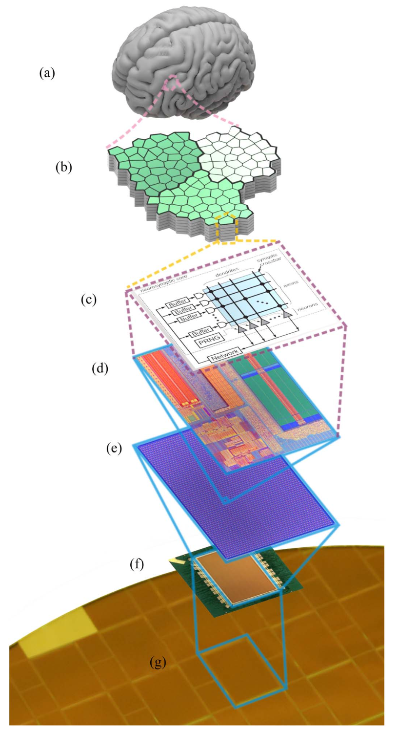
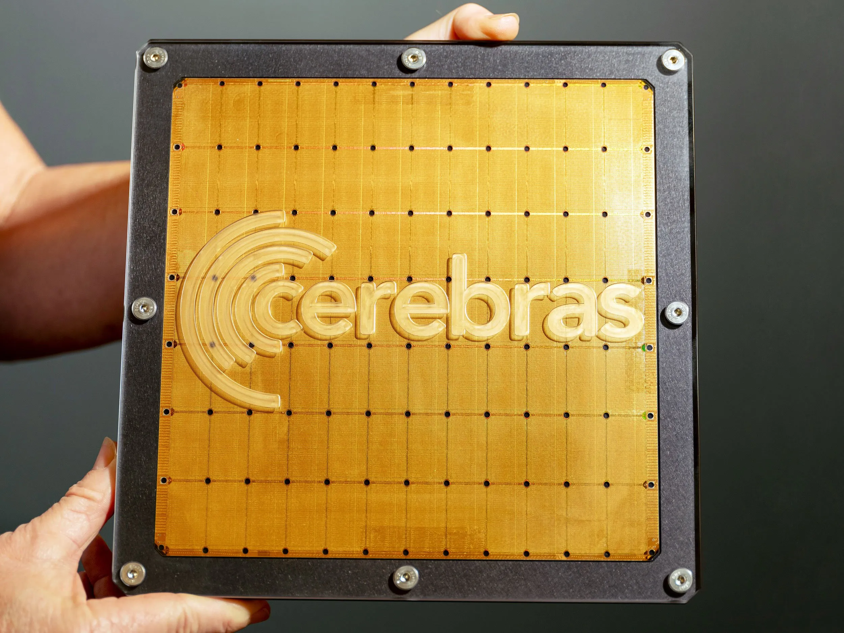
What are neuromorphic chips?
Neuromorphic chips are specialized hardware designed to mimic the structure and function of the human brain. Unlike traditional computing architectures, these chips are built to process information in ways similar to biological neural networks.
Cerebras WSE-3
300-millimeter wafer
4 trillion transistors
TSMC 5nm
57x larger than an NVIDIA H100
Accelerate AI workloads, particularly training and inference of large language models.
Not considered a neuromorphic chip

Slide 4
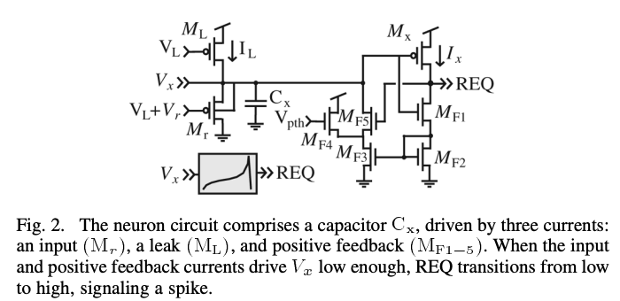
The usual trade-offs…!
Why not do everything in software?
Akida
Loihi
Loihi/2
BrainScaleS/2
T1
SpiNNaker
IBM’s TrueNorth
IBM’s NorthPole
Flexibility
Performance
More digital circuits
Other trade-offs:
Power
Reliability
Programmability
On-chip learning
Cost
Scalability
More analog circuits
But:
Digital backend needed
DAC/ADC
LIF neuron
DOI: 10.1109/TCSI.2010.2089556

Slide 5
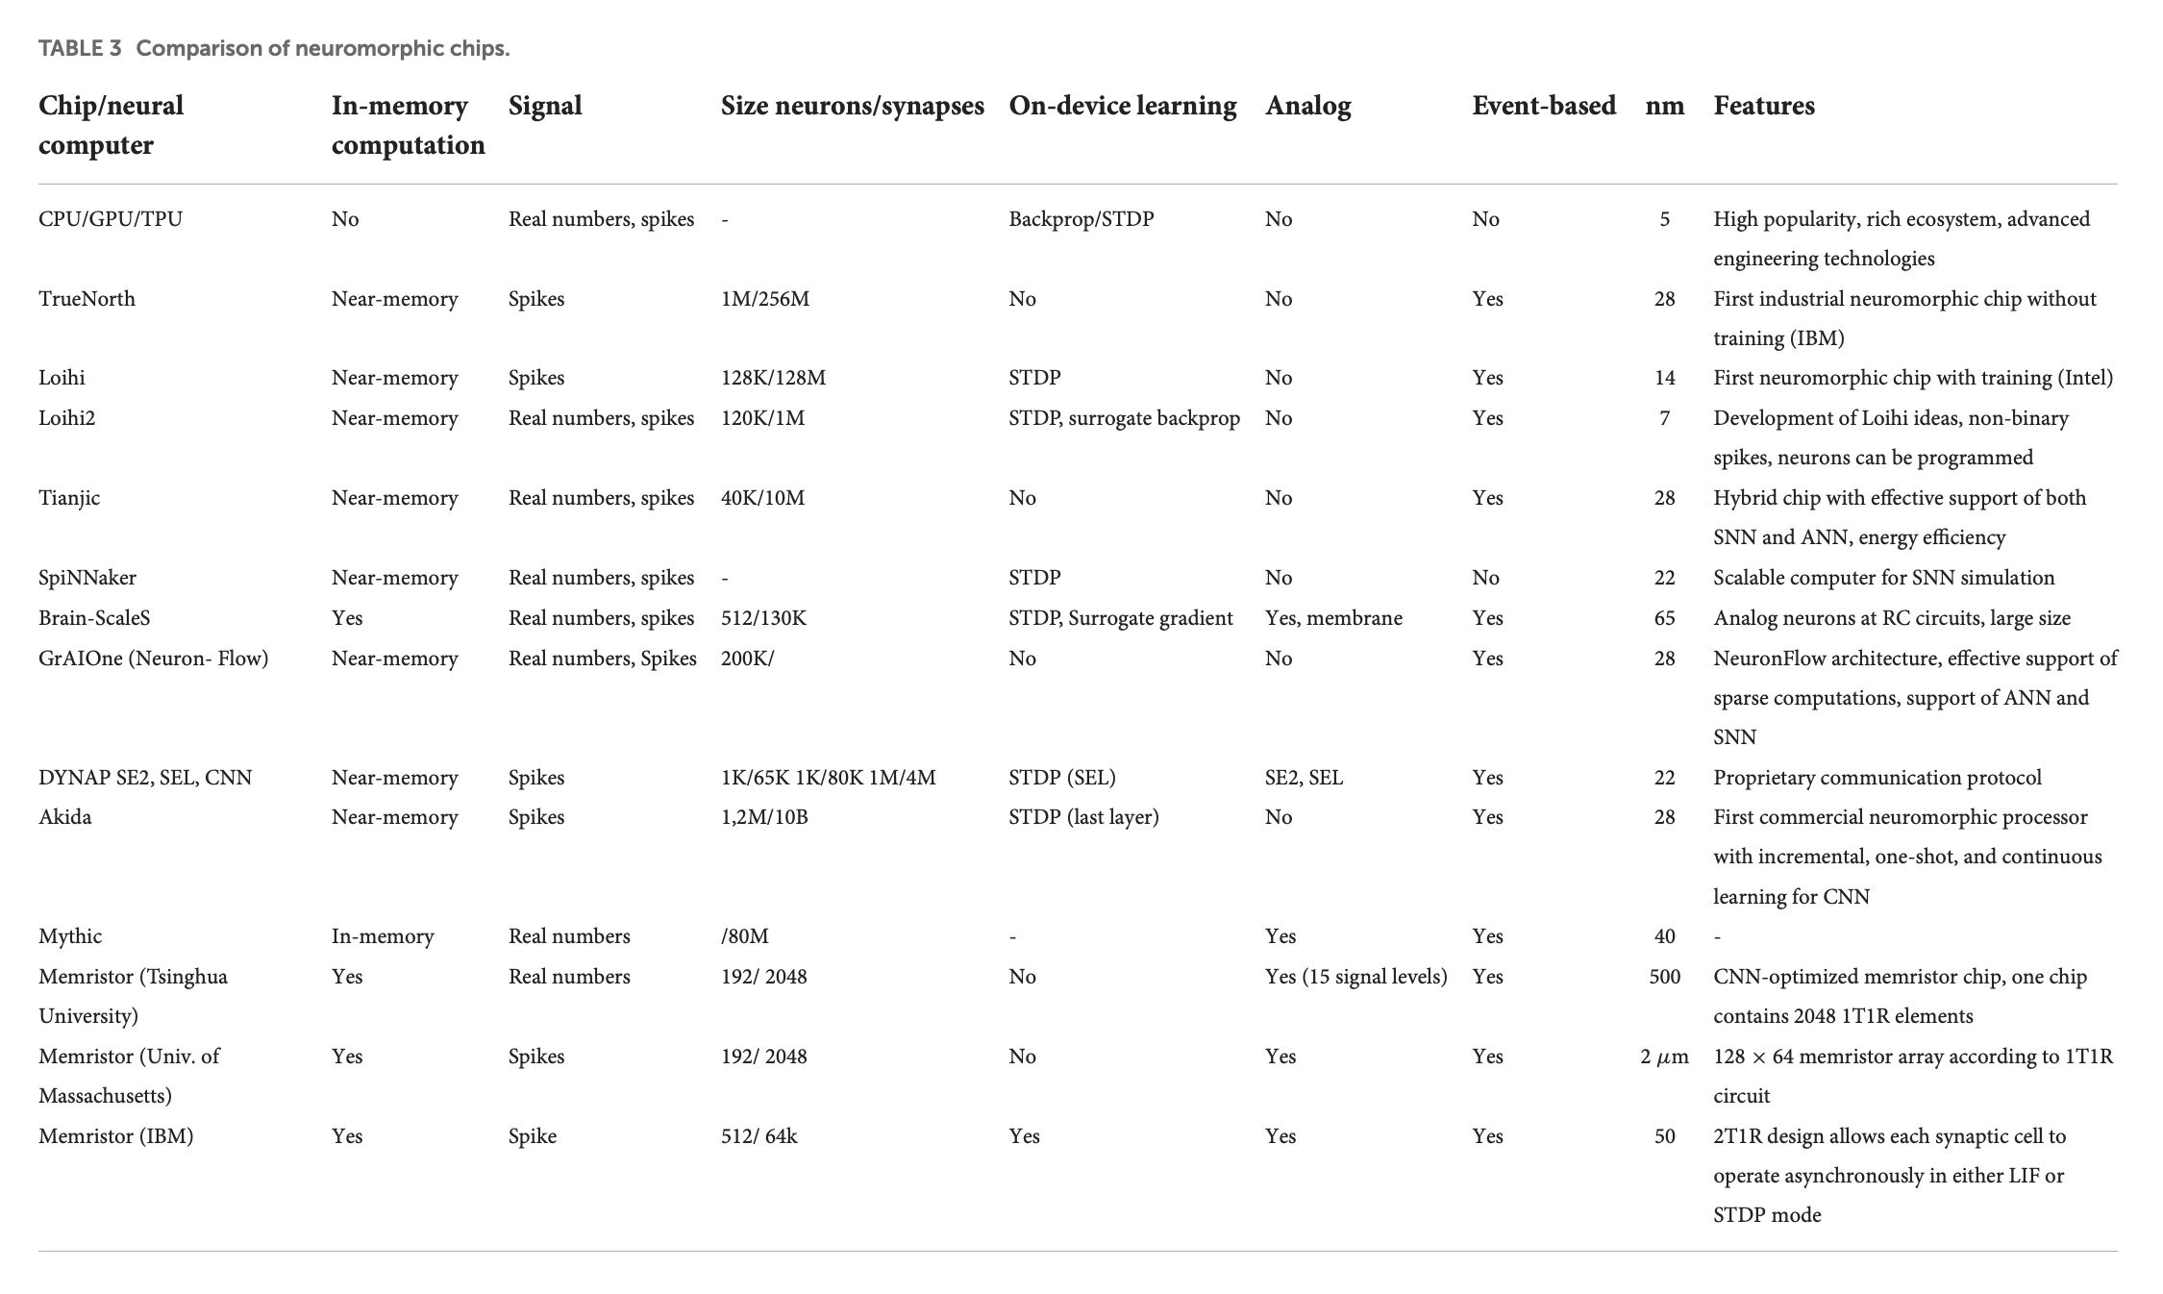
https://doi.org/10.3389/fnins.2022.959626

Slide 6
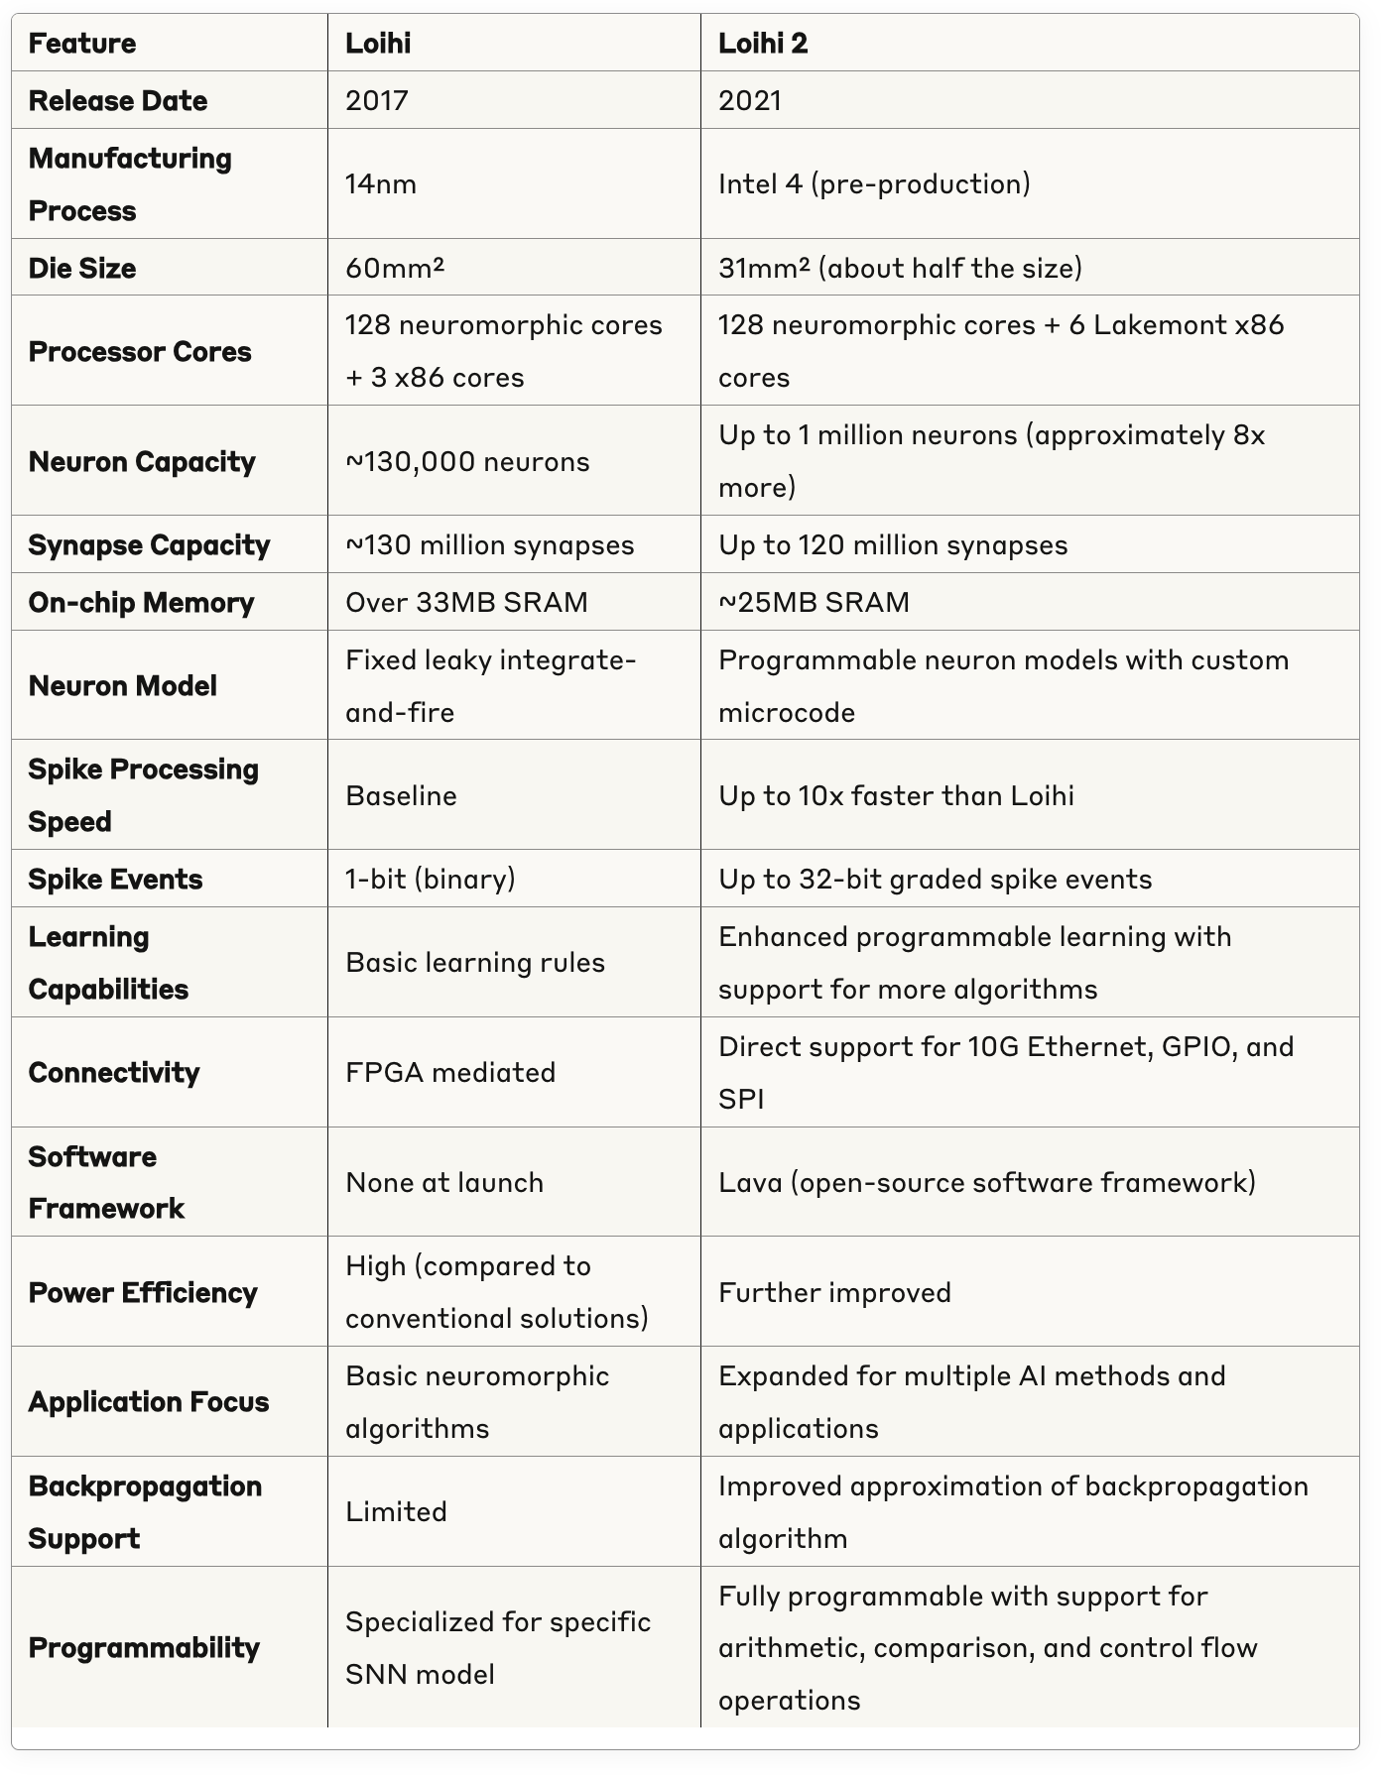
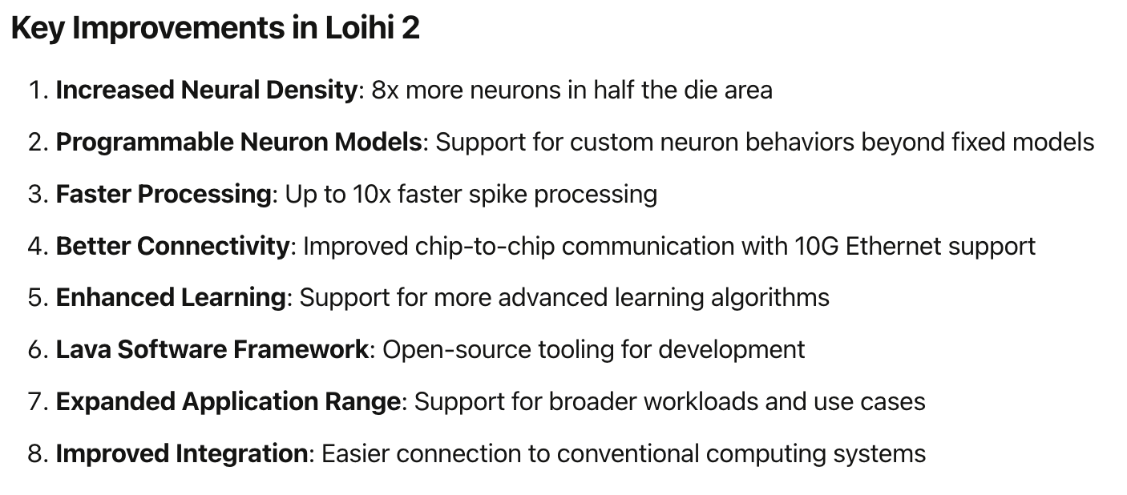
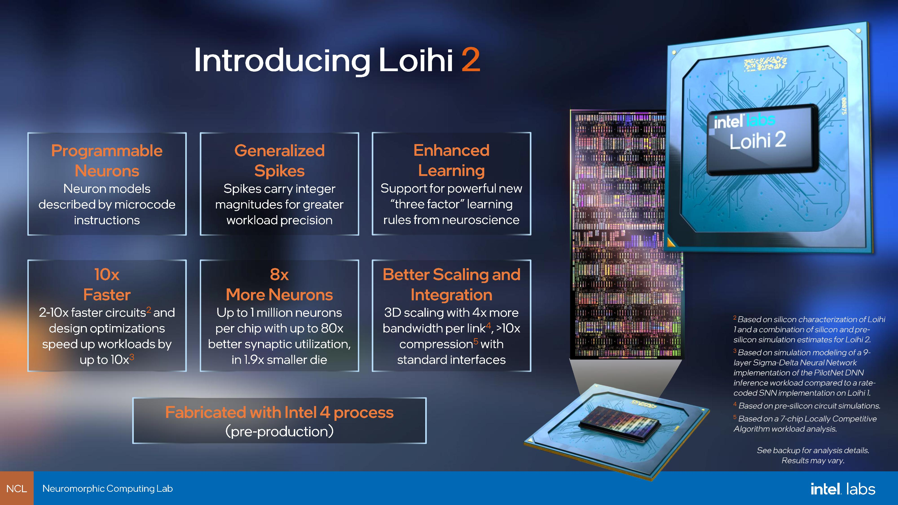

Slide 7
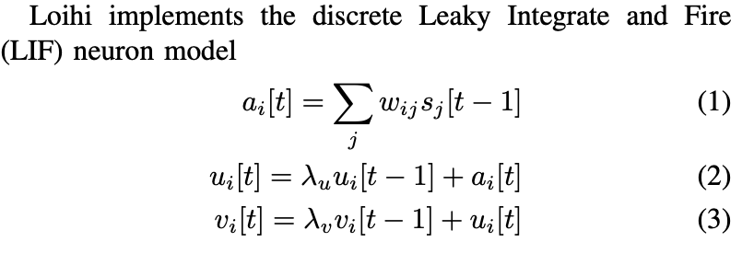
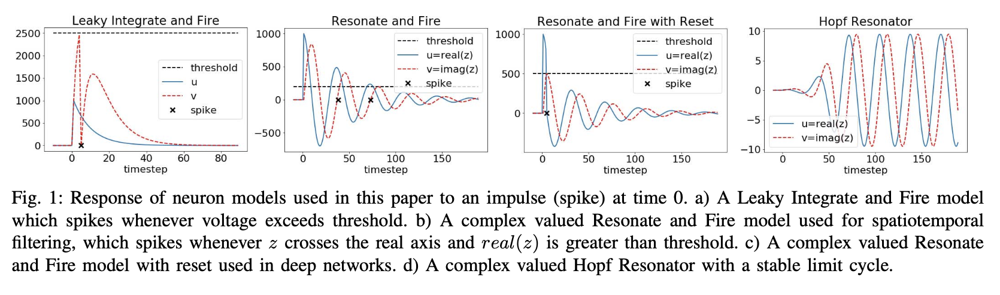
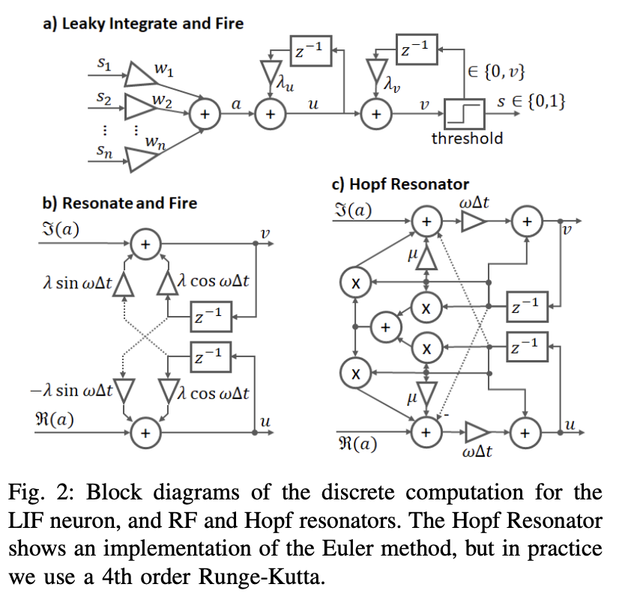
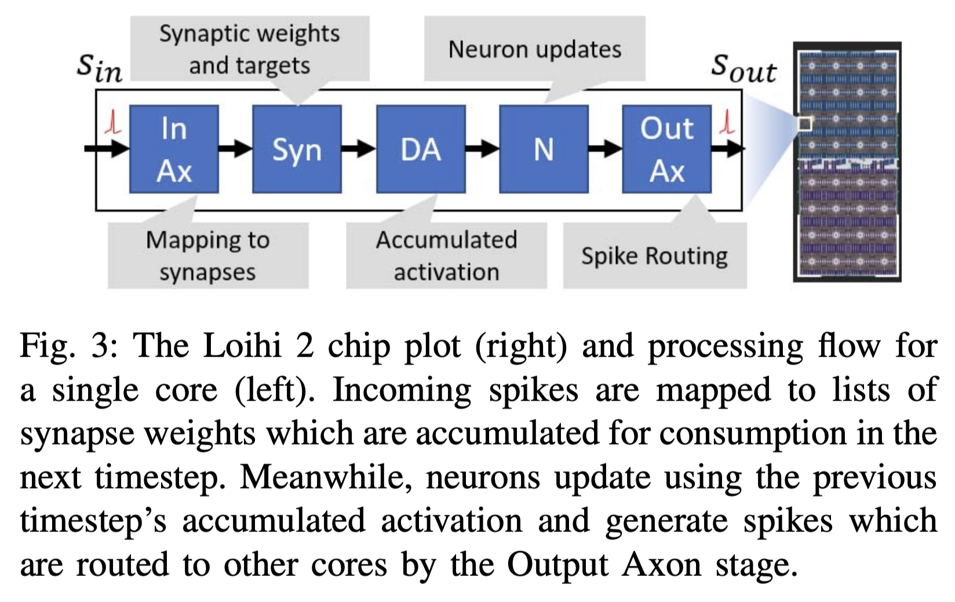
Loihi 2
DOI 10.1109/SiPS52927.2021.00053

Slide 8
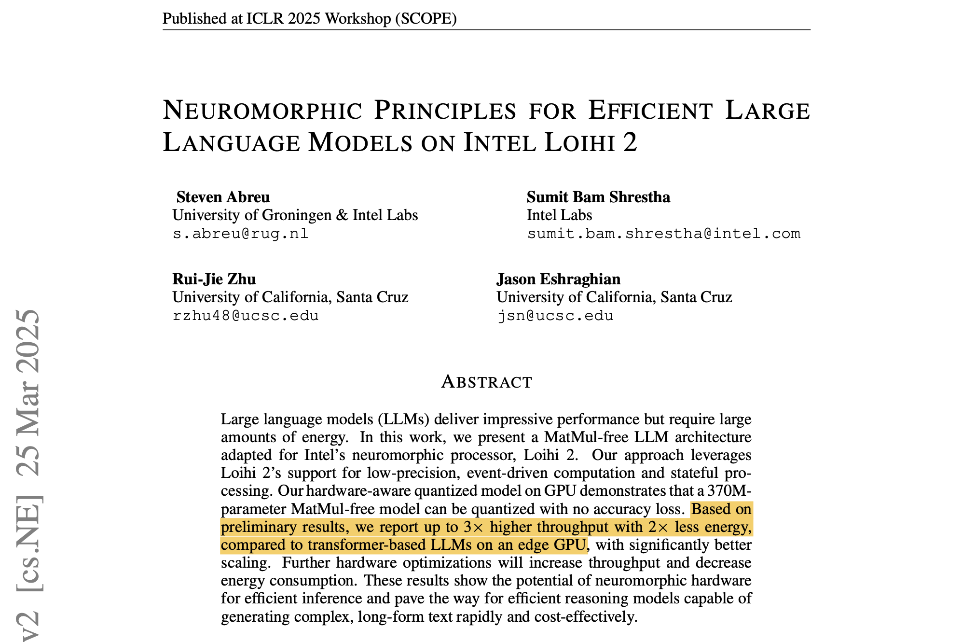
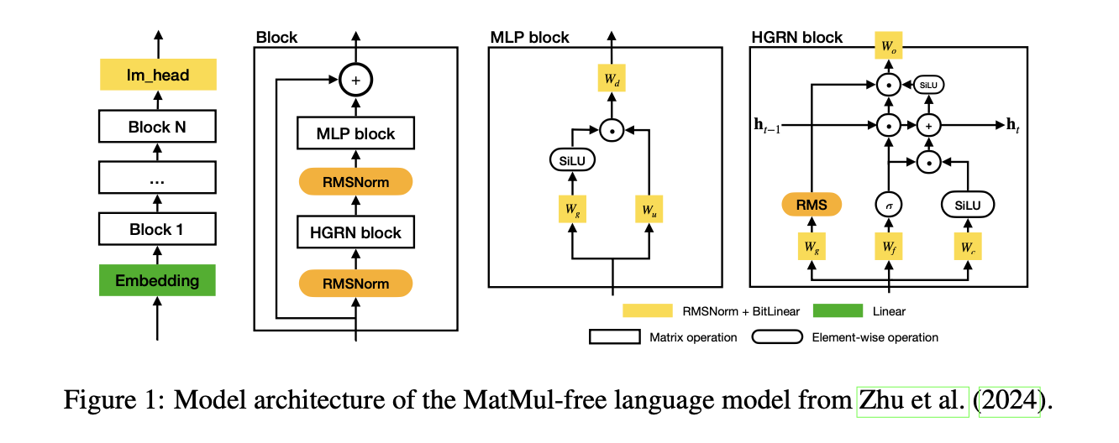
LLM on Loihi 2
Why is that gain performance not impressive?
arXiv:2503.18002v2

Slide 9
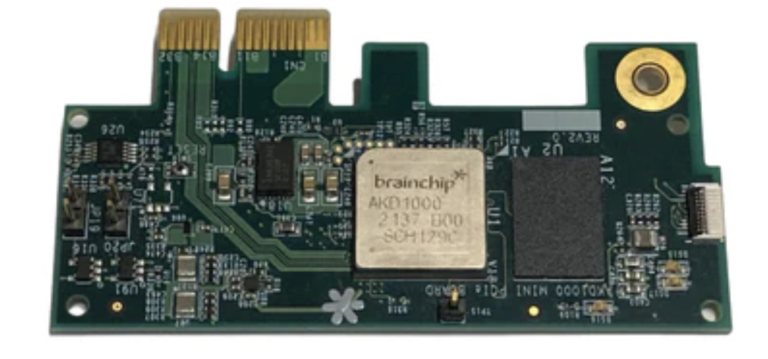
Akida
Akida (Vanarse et al., 2019) is the first commercial neuromorphic processor, commercially available since August 2021.
BrainChip's Akida is an ultra-low-power neuromorphic processor inspired by the brain’s neural architecture. It accelerates complex AI at the edge through event-based processing, on-chip learning abilities, and support form advanced neural networks like CNNs, RNNs & custom Temporal Event-based Nets.
Temporal Event-based Neural Networks (TENNs), which combine spatial and temporal convolutions to efficiently process sequential spatiotemporal data.
Akida’s ecosystem provides a free chip emulator, TensorFlow compatible framework MetaTF for the transformation of convolutional and fully connected neural networks into SNN, and a set of pre-trained models.

Slide 10
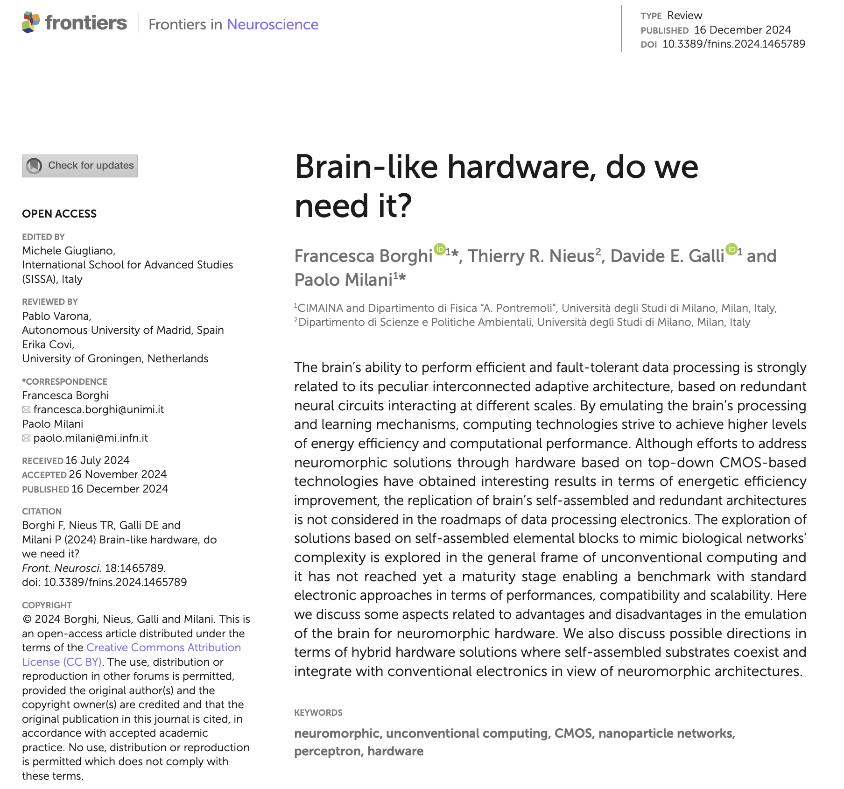
Do we need brain-like HW?
“Although efforts to address neuromorphic solutions through hardware based on top-down CMOS-based technologies have obtained interesting results in terms of energetic efficiency improvement, the replication of brain’s self-assembled and redundant architectures
is not considered in the roadmaps of data processing electronics.”
DOI: 10.3389/fnins.2024.1465789

Slide 11
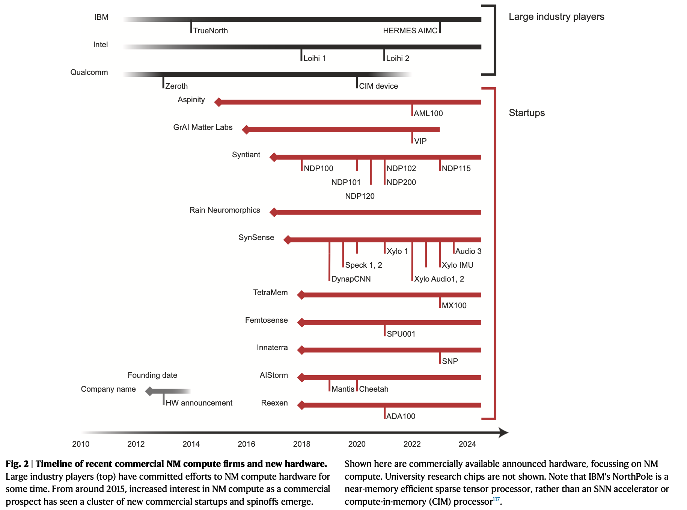
https://doi.org/10.1038/s41467-025-57352-1

Slide 12
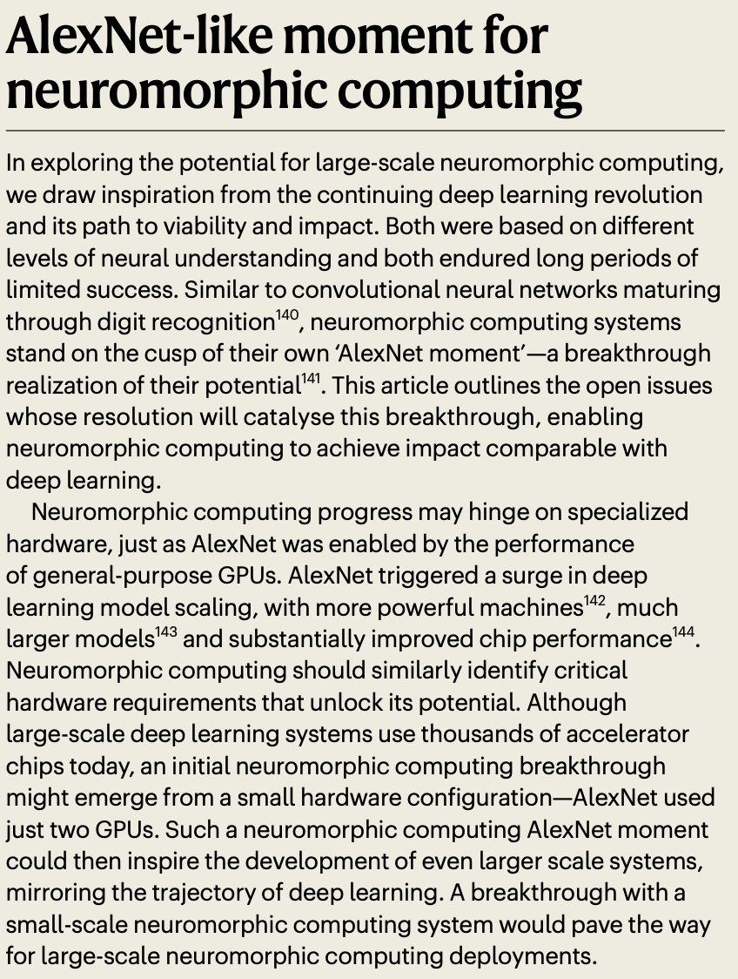
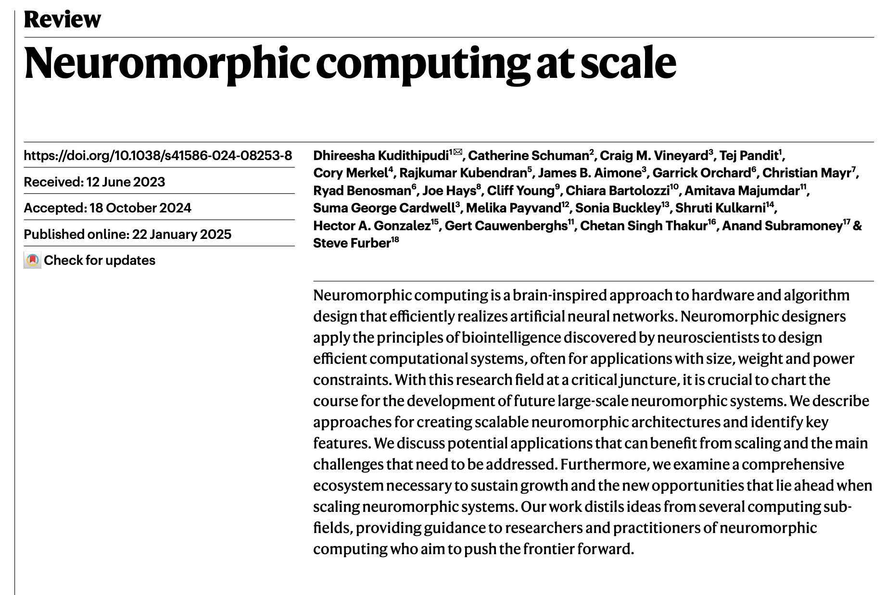
https://doi.org/10.1038/s41586-024-08253-8

Slide 13
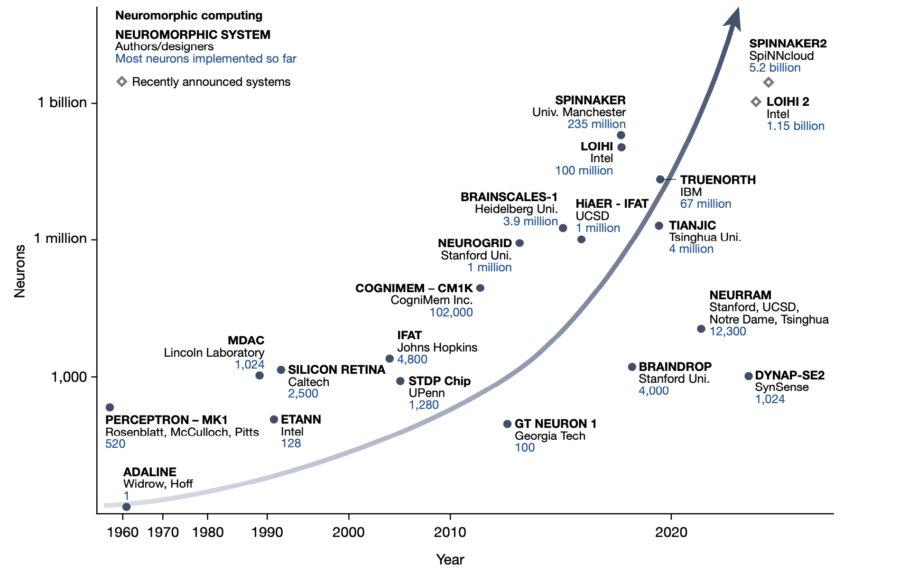
Progression of neuromorphic computing systems
https://doi.org/10.1038/s41586-024-08253-8

Slide 14
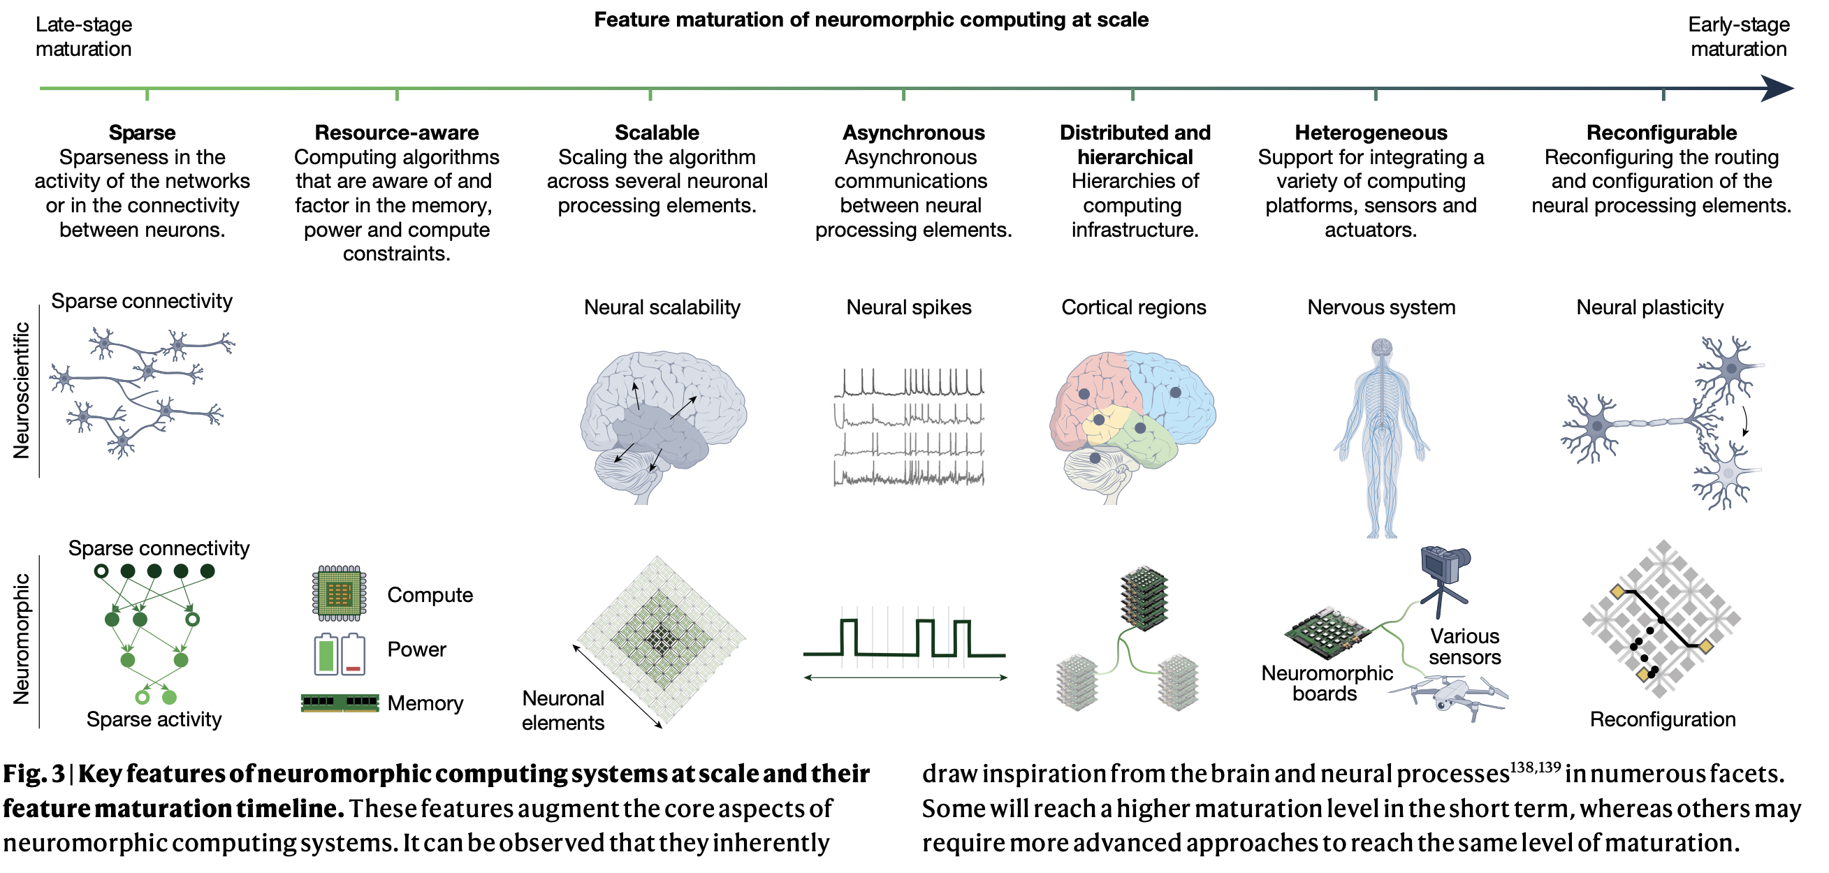
Feature maturation of neuromorphic computing
https://doi.org/10.1038/s41586-024-08253-8

Slide 15
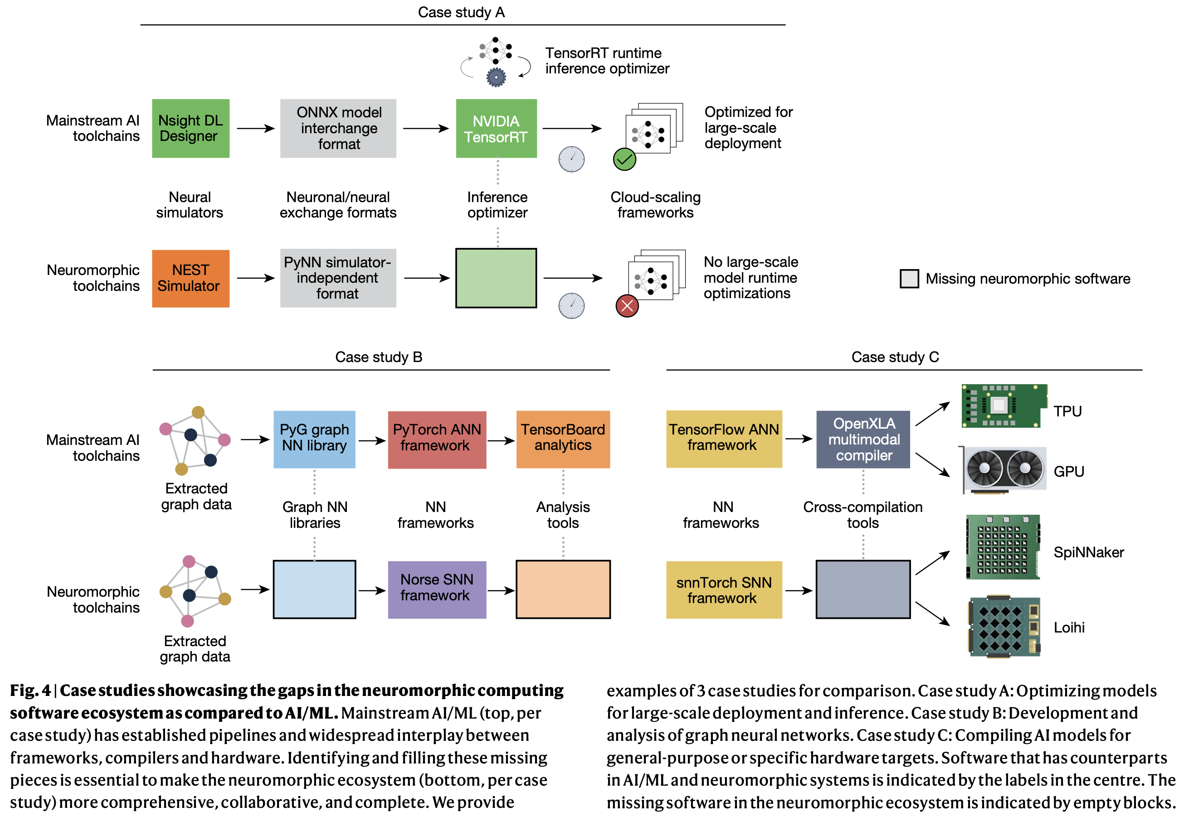
Gaps in neuromorphic computing
https://doi.org/10.1038/s41586-024-08253-8

Slide 16
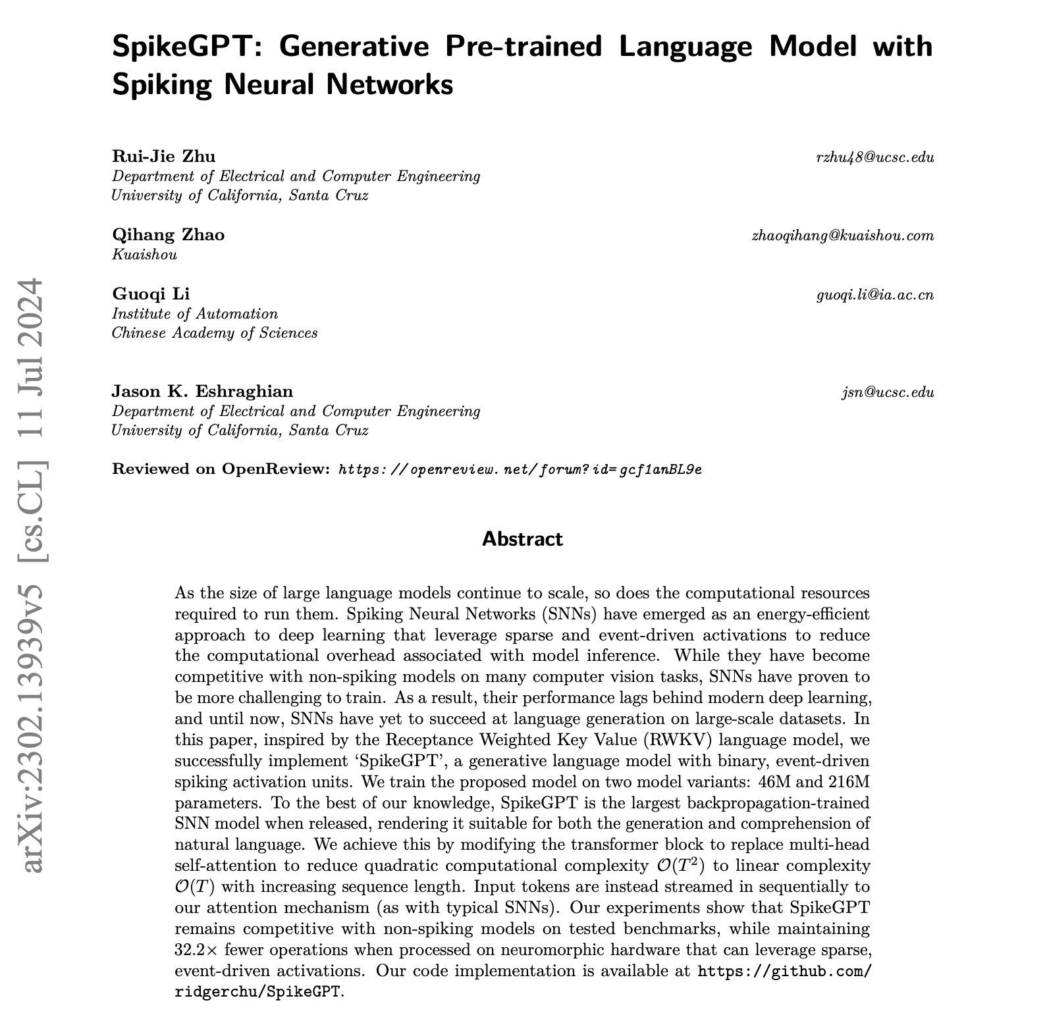
Are spikes the future for LLMs?
SNN can’t be trained with backpropagation. STDP is used instead.
Local learning only
Credit assignment problem
Lack of scalability and efficiency
Lack of global optimization objective
No mathematical convergence guarantee
Transformers are inherently un-brain–like.
The attention mechanism requires matrix-matrix multiplication. Hard to implement in neuromorphic architectures.

Slide 17
Recap: neuromorphic chip design choices
Spikes vs analog
Stochastic vs reduced precision vs full precision
In-memory vs near-memory vs von Neumann
NoC vs shared bus vs wires
Inference and/or learning
Crossbar vs non-crossbar
Neuron circuitry vs configurable neuron vs programmable neuron
STDP vs backprop vs other learning rules
Embedded vs datacenter
Number of neurons vs complexity of neuron and/or learning rate
Amount of memory

Slide 18
What other options do we have to
accelerate AI/ML algorithms?

Slide 19
Mem-elements
Compute closer to the physics.
Compute with the physics.

Slide 20
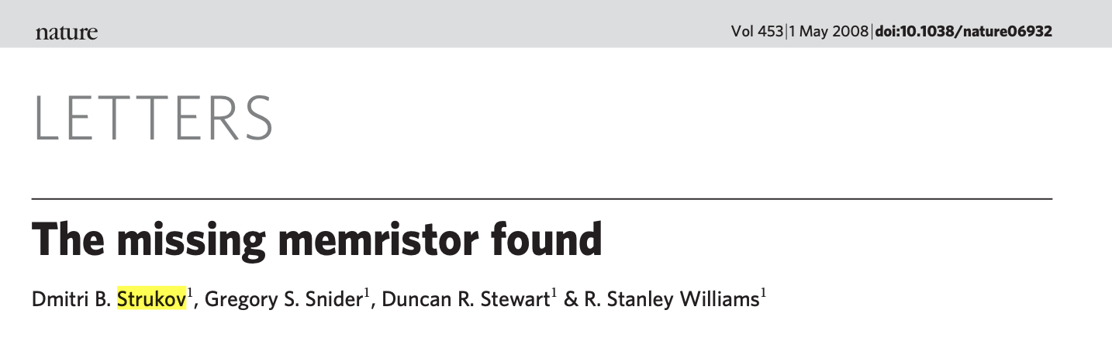
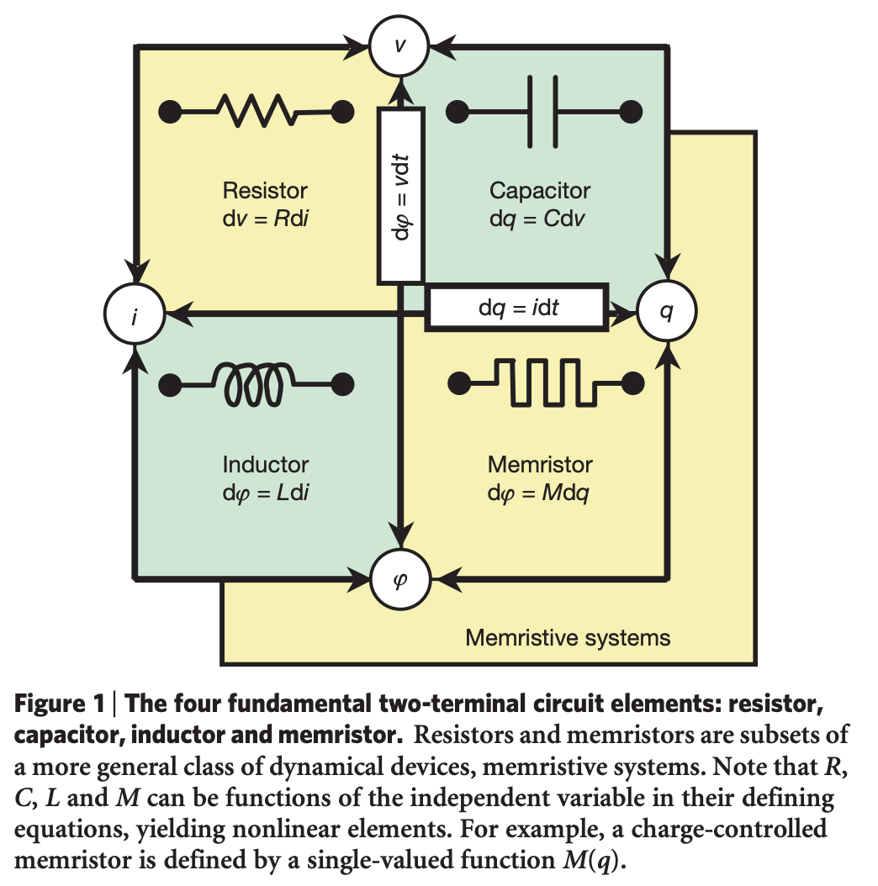
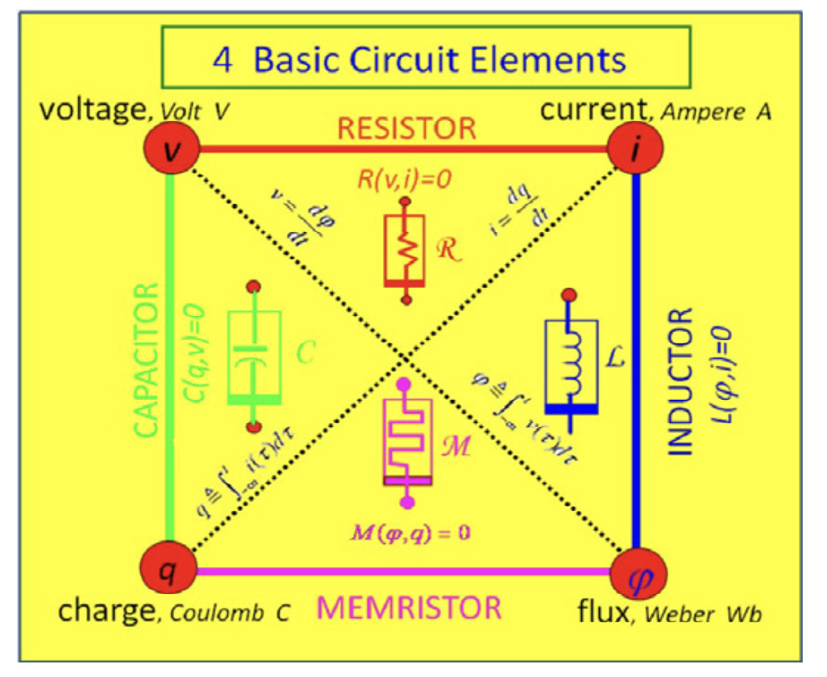
Mem-elements
1971: Chua predicted missing circuit elements
Memristor:
Variable resistance that depends on the history of current that has flowed through the device.
Ability to "remember" its previous resistance state even when power is turned off.
Non-volatile memory properties (retains information without power)
HP: TiO₂ devices
https://doi.org/10.1038/nature06932

Slide 21
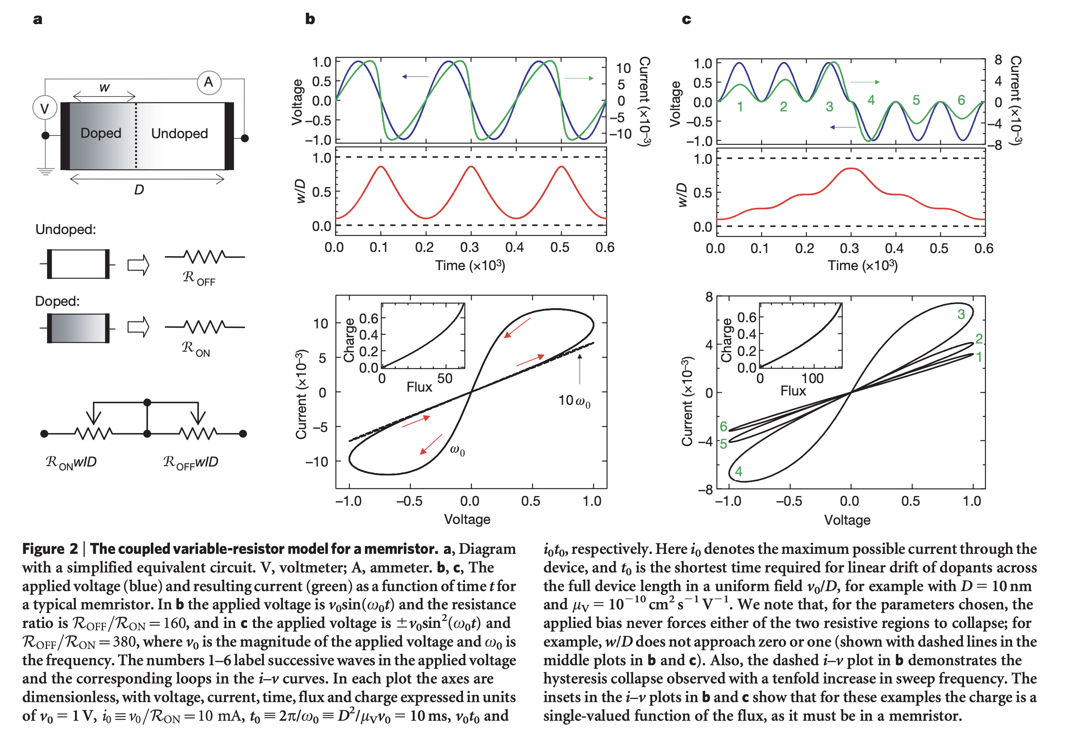
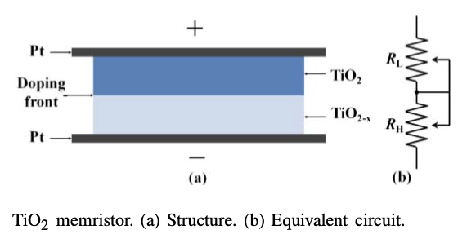
Memristors
https://doi.org/10.1038/nature06932

Slide 22
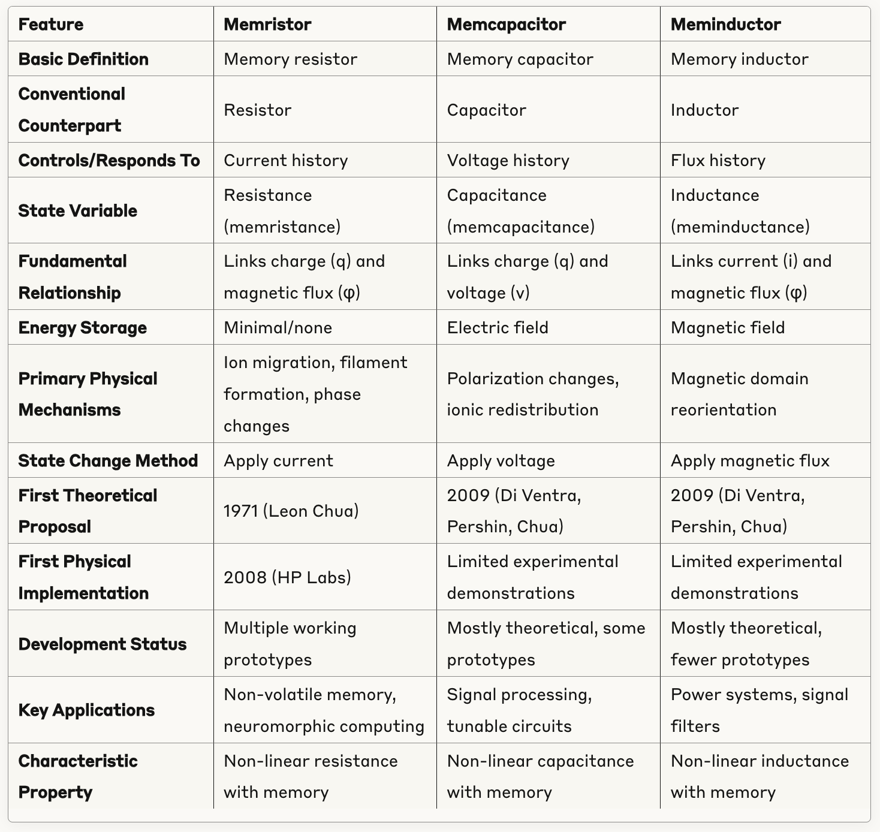
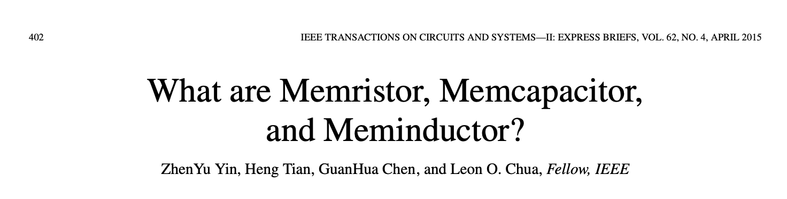
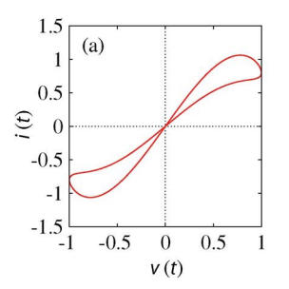
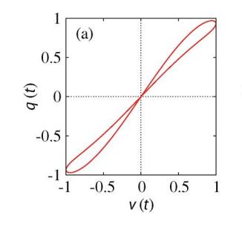
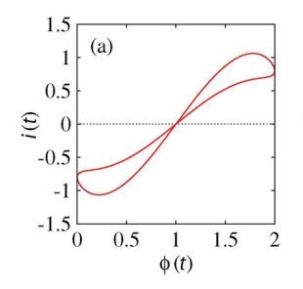
Memcapacitor and meminductor
Memristor state change: apply an electric current through the device.
Memcapacitors store energy in electric fields and respond to voltage history rather than current history.
Meminductor state change: create magnetic flux.
DOI: 10.1109/TCSII.2014.2387653

Slide 23
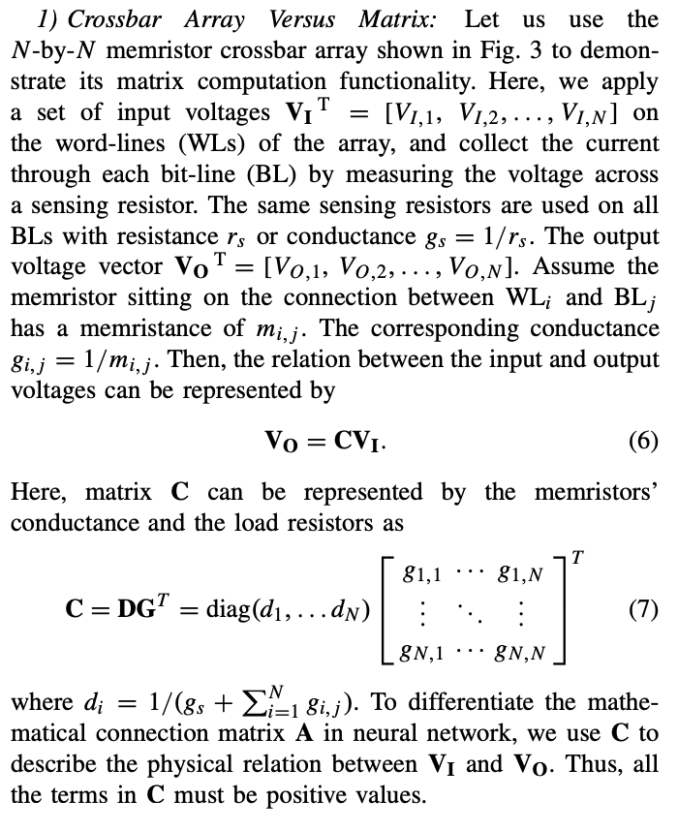
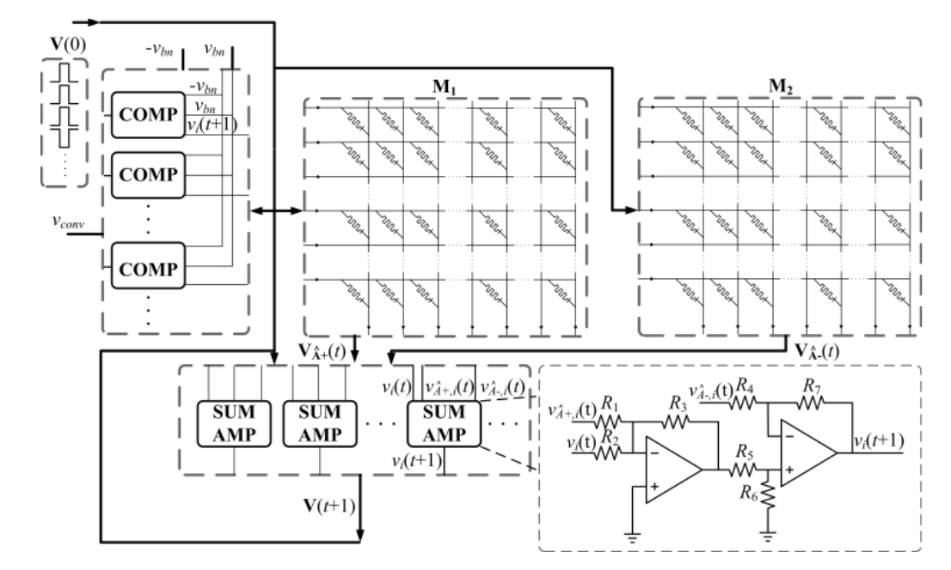
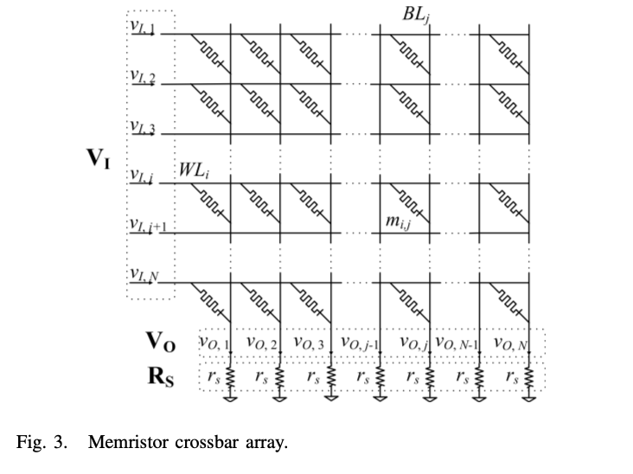
Memristors for neuromorphic chips
What to do with negative weights?
Positive weights
Negative weights
DOI: 10.1109/TNNLS.2013.2296777

Slide 24
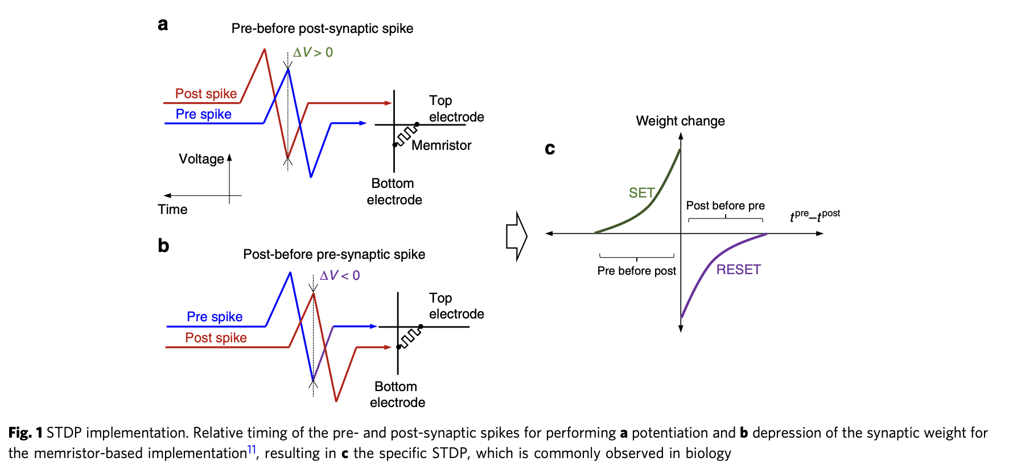
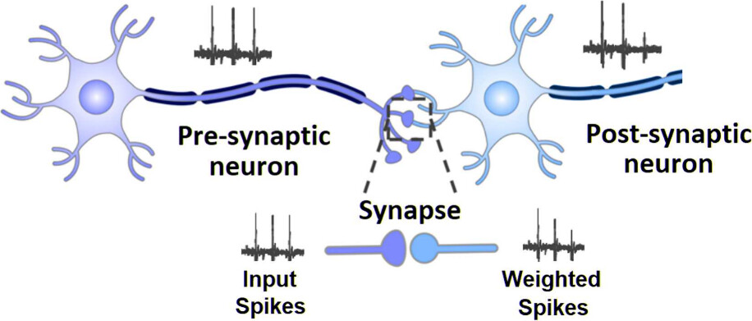
Memristors can implement STDP
STDP emerges naturally from device physics without complex circuits.
STDP: The time difference between spikes determines magnitude of change (closer timing = stronger effect)
STDP refines Hebbian learning by adding precise timing relationships. Unsupervised learning!
Memristors typically have threshold voltages required for changing state.
Only when spikes overlap sufficiently does voltage exceed the threshold.
https://doi.org/10.1038/s41467-018-07757-y

Slide 25
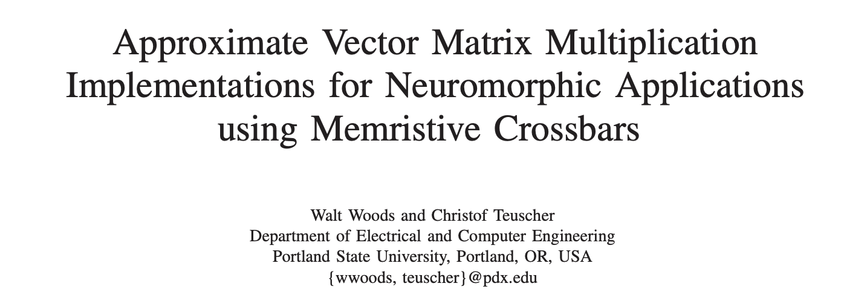
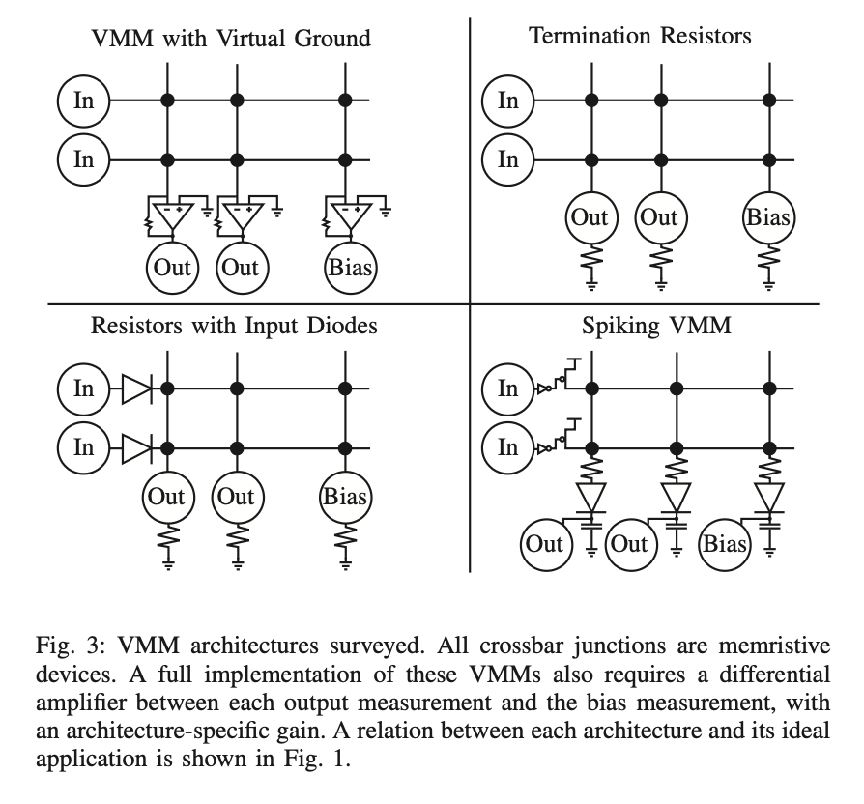
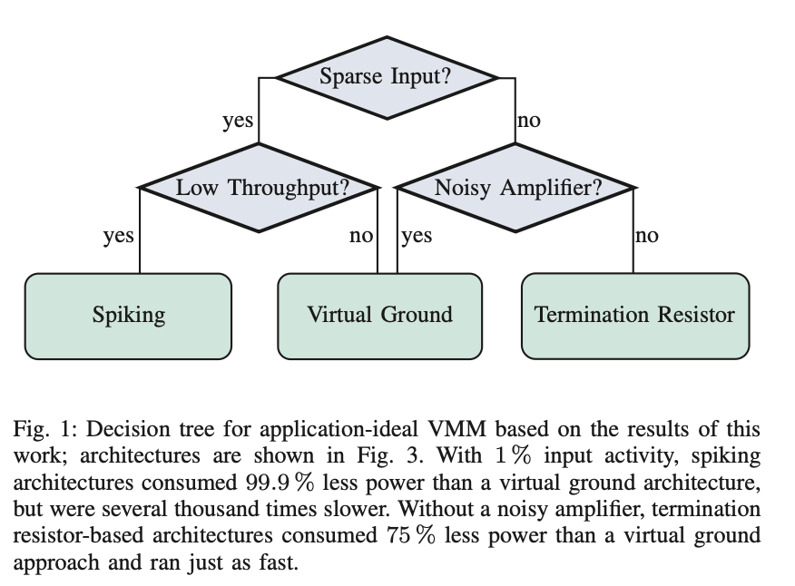
VMM using memristive crossbars
DOI: 10.1109/NANOARCH.2017.8053729

Slide 26
What is one problem of memristors?
https://www.nature.com/articles/s41928-021-00649-y

Slide 27
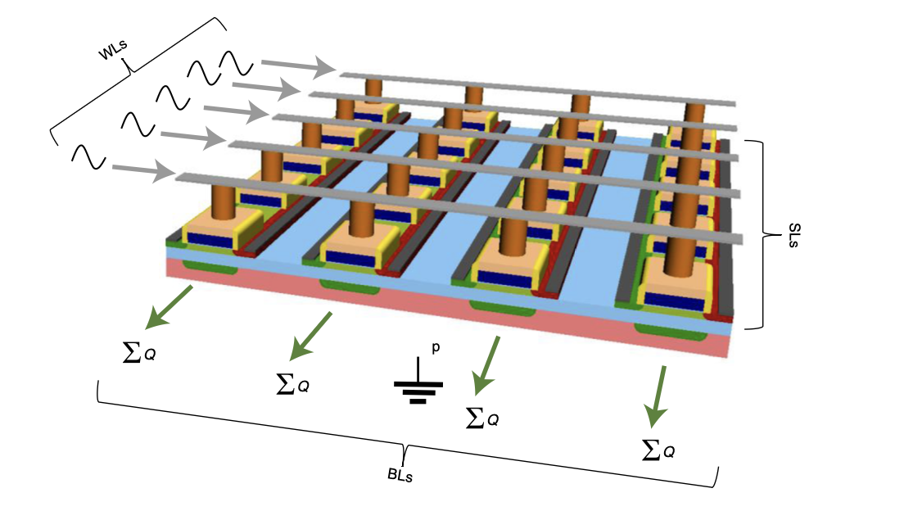
Memcapacitors
Memcapacitors offer several unique benefits, but one of their most significant advantages is their exceptional energy efficiency in dynamic computing applications.
Memcapacitors can implement STDP too (through charge).
https://doi.org/10.1038/s41928-021-00649-y

Slide 28
Issues with mem-devices
Device-to-device variation
Cycle-to-cycle variation
Limited write cycles (10⁶-10⁹ compared to CMOS >10¹⁵)
Retention issues / state drift
Programming complexity (requires precise pulses)
Limited switching speeds
Lack of design tools
https://doi.org/10.1038/s41928-021-00649-y

Slide 29
Unconventional computing
Unconventional Computing
?
Technology Brief | Taking Neuromorphic Computing to the Next Level with Loihi 2

Slide 30
What is computation?
Computation
Mapping
Transformation
Function O_{t+1}=f(I_{t})
Inputs I
Outputs O
…
…
How can we “realize” this mapping?

Slide 31
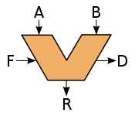
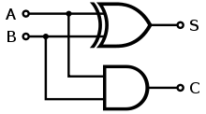
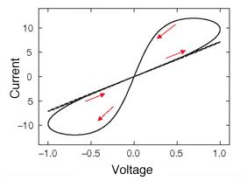
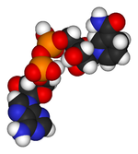

Intrinsic vs designed computation
Desired computation
Computing architecture
How to obtain a desired computation?
Intrinsic dynamics
Device network

Slide 32

What is Unconventional Computing (UCOMP)?
There is no precise definition…
“[…] a computing scheme that today viewed as unconventional may well be so because its time hasn’t come yet – or is already gone.” — Tommaso Toffoli
"Today, UCOMP is broad but (relatively) shallow, whilst CCOMP is narrow, but incredibly deep. What would computation look like if UCOMP were as deep as CCOMP, and there were an integrated theory combining all its aspects?" — Susan Stepney

Slide 33

Today’s unconventional computing spectrum (1)
Most definitely incomplete…
In-memory computing
Stochastic computing
Mem-element computing
Membrane computing
Multi-core
Quantum computing
Ising machines
Chaos computing
More classical
More unconventional
”Fringe”
GPU
FPGA
Fluidics
Neuromorphic
DNA computing
Analog computing
Cellular automata
Hypercomputation
Reservoir computing
Thermodynamic computing
Bacterial computation
What should I “invest” in to reboot computing?
Materials – Devices & Circuits – Architectures – Software – Algorithms – Applications

Slide 34




Today’s unconventional computing topics spectrum (2)

Slide 35
The unconventional computing spectrum over time
”Fringe”
More unconventional
Examples:
FPGAs
reservoir computing
Neuromorphic computing
More classical
Time

Slide 36
The unconventional computing time horizon
Industry
Unconventional
…
More un- conventional
Today
5 years
10 years
15 years
20 years

Slide 37

Hype or computation?
Thermodynamic computation
GPUs
Gartner’s hype cycle
FPGAs
Quantum computing
DNA computing

Slide 38
UCOMP supporters
UCOMP critics
👍🏻
👎🏻
New technologies need time (and money) to mature.
Current comparison with state-of-the-art are not fair comparisons.
We need to start somewhere.
Often on shoestring budgets only.
No useful paradigms that can compete with conventional approaches.
The real, practical challenges to be solved are always kept comfortably far away.
Proving that we can compute a NAND function with a self-assembled nanowire network, for example, doesn’t move the needle.

Slide 39



Evolution of the popularity of “unconventional computing”
Several conferences and journals
Time
Source: Engineering Village, Inspec

Slide 40

The decline of traditional computer architecture
The number of records over the years that were found for the “computer architecture” thesaurus term. The field had its peak around 1985 and has since been in decline. Data source: Elsevier Engineering Village thesaurus.

Slide 41

Popularity of selected individual UCOMP approaches
Source: Engineering Village, Inspec
Stochastic
Reservoir
Thermodynamic
Hypercomputation

Slide 42



Source: Engineering Village, Inspec
Hit?
Reservoir computing
What did we overlook?
Miss?
Cellular automata

Slide 43

What is material and Physical Reservoir Computing (PRC)?
A physical reservoir computer is a system in which the reservoir is realized with a physical system.
Source: Tanaka et al., Recent advances in physical reservoir computing: A review, 2019, https://doi.org/10.1016/j.neunet.2019.03.005

Slide 44
Questions of interest for Physical Reservoir Computing (PRC)
How much control does on have over the fabrication process?
Reproducibility of input-output mapping?
How to interface with a material/device?
Memory capacity?
Signal attenuation/amplification?
Cycle-to-cycle variation?
Device-to-device variation?
In-situ or ex-situ training? The challenging part tends to be the in materio implementation of the readout and training.
What pre- and post-processing is necessary? What will it “cost?”
…

Slide 45


Pattern recognition in a bucket (1)
4 electric motors perturb water surface
320x240 pixels, 5 frames webcam films inference patters
Sobel edge detection mask that was suitably thresholded to remove noise and averaged to produce a 32x24 grid. The cells of this matrix were used as the input values for 50 perceptrons in parallel
XOR task
Speech recognition (“zero”/”one” task)
25% mistakes with single perceptron
1.5% mistakes when passed through water.
Water tank
Overhead projector
DOI: 10.1007/978-3-540-39432-7_63

Slide 46


Pattern recognition in a bucket (2)
Fernando and Sajakka experiment replication.

Slide 47


RC based on solitary-like waves dynamics of film flows
Mackey-Glass time series task
An electric signal modulates the pump flow: ’1’ states are implemented as a brief change in the flow rate that results in the generation of one.
Camera used for outputs. Output layer in software.
Maksymov & Pototsky, Reservoir computing based on solitary-like waves dynamics of film flows: a proof of concept, 2023, https://arxiv.org/abs/2303.01801

Slide 48


Plant reservoir computing

Slide 49



Computing with networks of nonlinear mechanical oscillators
Training
Parity task
Target
Anharmonic = not simply harmonic
Springs with damping. Random couplings.
u(t)
Different parities
Network output
N= 400 oscillators
Parity + spoken words tasks
Numerical simulations only.
Coulombe, Computing with networks of nonlinear mechanical oscillators, 2017, https://doi.org/10.1371/journal.pone.0178663

Slide 50



Reservoirs with atomic switch networks
Spoken digits task
Silver iodide (Agl) junctions
14 electrodes
Self-organizing systems
Lilak, Woods, Scharnhorst K, Dunham, Teuscher, Stieg, Gimzewski, Spoken Digit Classification by In-Materio Reservoir Computing With Neuromorphic Atomic Switch Networks, 2021, http://doi.org10.3389/fnano.2021.675792

Slide 51


Dynamic memristors for temporal information processing
Experimental demonstration of a memristor-based RC system using dynamic
memristor devices that offer internal, short-term memory effects. 88 memristors.
State decay
Implemented in Matlab
Source: Du et al. Reservoir computing using dynamic memristors for temporal information processing. Nat Commun 8, 2204 (2017). https://doi.org/10.1038/s41467-017-02337-y

Slide 52


Reconfigurable perovskite nickelate electronics
Perovskite nickelate devices act as memristors and memcapacitors for RC.
Source: Zhang et al., Reconfigurable perovskite nickelate electronics for artificial intelligence, 2022, https://doi.org/10.1126/science.abj7943

Slide 53




First Josephson Junction (JJ) reservoir (1)
Toggle FF
Josephson transmission line (superconducting oscillators)
>100GHz
Inputs to selected JJs only
Signal reconstruction
https://www.youtube.com/watch?v=1bWjyQ1326g
Wave-like reservoir response
Task: speech recognition. ~70% accuracy. 5 JJs.
Rowlands et al., Reservoir Computing with Superconducting Electronics, 2021, https://arxiv.org/abs/2103.02522

Slide 54


First Josephson junction reservoir (2)
Actual JJ chip
Screenshots from https://www.youtube.com/watch?v=1bWjyQ1326g
Article: Rowlands et al., Reservoir Computing with Superconducting Electronics, 2021, https://arxiv.org/abs/2103.02522

Slide 55


Optoelectronic RC (general idea)
Mach-Zehnder modulator
Non-linearity
New state
Photonic reservoirs are all about high speed. The challenge is to make them small.
Input
Input
Previous state
Paquot et al., 2012, http://www.doi.org/10.1038/srep00287

Slide 56





DNA oscillators as reservoirs
Readout in software
Goudarzi, Lakin, and Stefanovic, DNA reservoir computing: a novel molecular computing approach, 2013, https://doi.org/10.1007/978-3-319-01928-4_6
Yahiro et al., Alife, 2018, https://doi.org/10.1162/isal_a_00013
Used same oscillator as Goudarzi et al.
Simulation only. Similar performance as Goudarzi.
Input species
Microfluidic reaction chamber
Cycle
Line

Slide 57


Open problems, challenges, and opportunities
Scale up PRC systems to massive numbers of neurons.
Train modular/hierarchical reservoirs efficiently.
Multitasking reservoirs.
Lifelong/incremental learning with growing reservoirs (developmental systems).
Implement readout/learning directly in materio.
Find sweet spots for high-speed, low-power, high performance, and high robustness.
Reservoirs that adapt, are tuned, or reconfigured (in-situ).
Material reservoir (deep) co-evolution.

Slide 58
Quo vadis?
Material computing has attracted increasing attention: it allows for solving computational problems for which traditional, general-purpose architectures are not efficient.
PRC has great potential for physically “embedding” computing in a substrate by using the substrate itself to perform the computation.
A broad(er) success of PRC will be contingent on finding solutions to the open questions and challenges: identify physical substrates, scaling up hardware, scaling up programmability → (deep) co-design.

Slide 59


What are good metrics to evaluate UCOMP approaches?
Gain
Signal to noise ratio
Scalability
“[...] there is nothing on the horizon that has promise to replace CMOS at least in the next ten to fifteen years.”
Is that still true?
IRDS 2022, BC

Slide 60


The goals and drivers have changed and keep changing
Avogadro-scale computing
Large number
IDRD, 2022, BC

Slide 61
Deep co-design: our best path forward?
Given a proposed unconventional computing substrate, we can ask:
Does it actually compute?
If so, how well does it compute?
Can it be made to compute better?
Given a proposed unconventional computational model, we can ask:
How powerful is the model?
Can it be implemented in a substrate?
How faithfully or efficiently can it be implemented?
Given complete freedom in the choice of model and substrate, we can ask:
Can we co-design a model and substrate to work well together?
Stepney, S., Co-designing the computational model and the computing substrate. In Proceedings of the 18th International Unconventional Computation and Natural Computation Conference, pp 5-14, 2019.

Slide 62



Deep co-design across the entire stack

Slide 63


Deep co-design: what we need to make this happen…
A formal framework for in-materio computing:
continuous
open
stochastic
non-equilibrium
non-linear
…
Revisit the stack (or get rid of it?)
More comprehensive design space exploration at all levels.
Stepney, 2018

Slide 64


Each paradigm has unique strengths and faces distinct challenges. The most practical near-term applications are likely in specialized neuromorphic chips while quantum and DNA computing represent longer-term possibilities for specific problem domains.
The reality is that future computing systems will likely be hybrid, combining multiple paradigms to leverage their respective strengths - such as using photonic interconnects with electronic processors, or quantum-classical hybrid systems for optimization problems.

Slide 65

Where should we look for the next big thing?
ICRC 2023
poll

Slide 66




Look for specialists, not generalists

Slide 67

Action items for the community
Look for specialists
Formal frameworks
(Unified?) evaluation metrics
Roadmap(s)
Timelines to solutions
Scott Holmes

